Slide 1

A Zero Trust-Driven Framework for Mitigating Access Control Misconfigurations in Multi-Cloud Environments
Vishal Gowda V, Harshad K Reddy
Vellore Institute of Technology, Vellore, India

Slide 2
Project Introduction & Objectives
Problem Statement
Project Objective
Access control misconfigurations in multi-cloud environments are cited in nearly 90% of cloud security breaches, including overly permissive IAM policies, unsecured storage buckets, and lateral privilege escalations.
Develop a Zero Trust-driven framework that integrates Infrastructure-as-Code (IaC) auditing, continuous monitoring of runtime configurations, and automatic policy remediation to secure cloud-native environments.
Our approach combines infrastructure template scanning, real-time policy auditing, and automated remediation to address limitations in visibility, compliance, and control across dynamic, heterogeneous multi-cloud infrastructures.

Slide 3
Literature Survey (1/2)
Recent studies (2020 and beyond) have focused on mitigating cloud access misconfigurations using dynamic access control, Zero Trust, and Infrastructure-as-Code scanning:
Base Paper: Federated Zero Trust Architecture using Artificial Intelligence
Cloud Service Misconfigurations: Emerging Threats
Unified Framework for Securing Cloud-Native Storage
Proposes a federated model for Zero Trust enhanced with AI, enabling adaptive decision-making and stronger authentication across distributed environments.
Explores common misconfigurations in cloud services and highlights how they lead to enterprise breaches, along with mitigation strategies.
Introduces a unified approach to secure multi-cloud storage buckets, preventing data leaks caused by misconfigured access policies.

Slide 4
Literature Survey (2/2)
Zero-Trust Based Dynamic Access Control
Security Issues in Multi-Cloud
Proposes a Zero Trust-driven adaptive model to dynamically adjust access policies in cloud infrastructures.
Provides a comprehensive review of security challenges in multi-cloud environments, including identity sprawl, policy conflicts, and compliance issues.
Cloud Native Network Security Architecture
Implementing Dynamic Confidential Computing
Suggests a Zero Trust-aligned security framework to strengthen network security in cloud-native systems.
Suggests a Zero Trust-based confidential computing model to continuously monitor and mitigate security threats across cloud environments.
These studies from IEEE, Elsevier, and Springer provide the foundation for our research approach.

Slide 5
Research Gap
Lack of Real-Time Responsiveness
Limited Context-Awareness
Absence of Automatic Remediation
Many IAM tools don't dynamically adapt to changing contexts such as workload variations or ephemeral resources.
Existing mechanisms detect misconfigurations only after the fact through periodic audits and static scans.
Most systems detect misconfigurations but require manual remediation, which is slow and prone to errors.
Fragmented Multi-Cloud Security
Weak Integration of Zero Trust
Lack of IaC-Aware Security
Few implementations focus on access control misconfigurations like IAM over-permissioning and lateral privilege escalation.
Many solutions do not integrate Infrastructure-as-Code auditing into security frameworks.
Cloud providers offer separate monitoring tools, lacking a unified mechanism for handling misconfigurations across multi-cloud setups.

Slide 6

Architecture Diagram
Our Zero Trust-driven framework integrates IaC auditing, continuous monitoring, and automatic policy remediation across multi-cloud environments, enforcing least-privilege access dynamically.

Slide 7
Hardware & Software Specifications
Hardware Requirements
Software Requirements
Processor: Intel i5/i7 or AMD Ryzen 5/7, ≥ 2.5 GHz
OS: Windows 10/11
Memory: 8 GB minimum (16 GB recommended)
Languages: Python, FastAPI/Flask
Storage: 256–512 GB SSD
IaC: Terraform, CloudFormation
Network: Stable broadband ≥ 20 Mbps
Containers: Docker, Kubernetes
Cloud: AWS, Azure, GCP
Zero Trust: OPA, Gatekeeper, Cloud Custodian
Monitoring: CloudTrail, Prometheus, Grafana

Slide 8
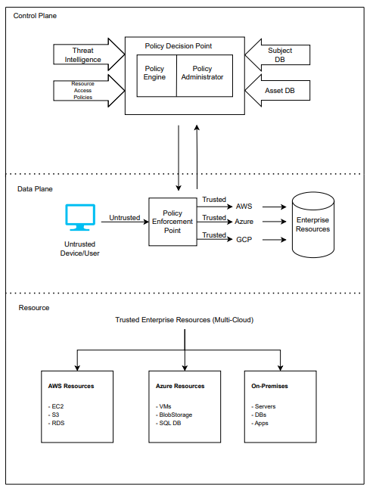

Slide 9






Module Split-up
IAM Monitoring Module
IaC Auditing Module
Policy Decision Point
Detect overly permissive policies, unsecured storage, and privilege escalations
Prevent misconfigurations at deployment stage
Evaluate access requests against security policies
Policy Enforcement Point
Remediation Module
Monitoring & Logging
Enforce PDP decisions before allowing access
Fix misconfigurations automatically
Provide visibility and feedback loops
The Multi-Cloud Resource Layer represents the actual enterprise resources protected by Zero Trust across AWS, Azure, GCP, and on-premises environments.

Slide 10

Gantt Chart & Timeline
The project implementation follows a structured timeline with parallel development of modules and integration phases to ensure timely completion and thorough testing.

Slide 11
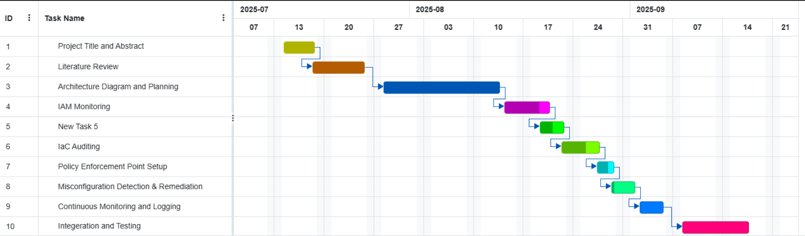

Slide 12



Key Takeaways
Zero Trust Integration
Multi-Cloud Unification
Automated Remediation
Our framework applies Zero Trust principles specifically to access control misconfigurations, addressing a critical gap in cloud security.
Provides a unified approach to security across AWS, Azure, and GCP environments, eliminating fragmented security monitoring.
Implements automatic policy remediation to fix overly permissive policies without human intervention, reducing response time.
By combining IaC auditing with runtime monitoring in a single security loop, our framework enables proactive prevention of access control misconfigurations while maintaining usability and performance.

